Slide 1

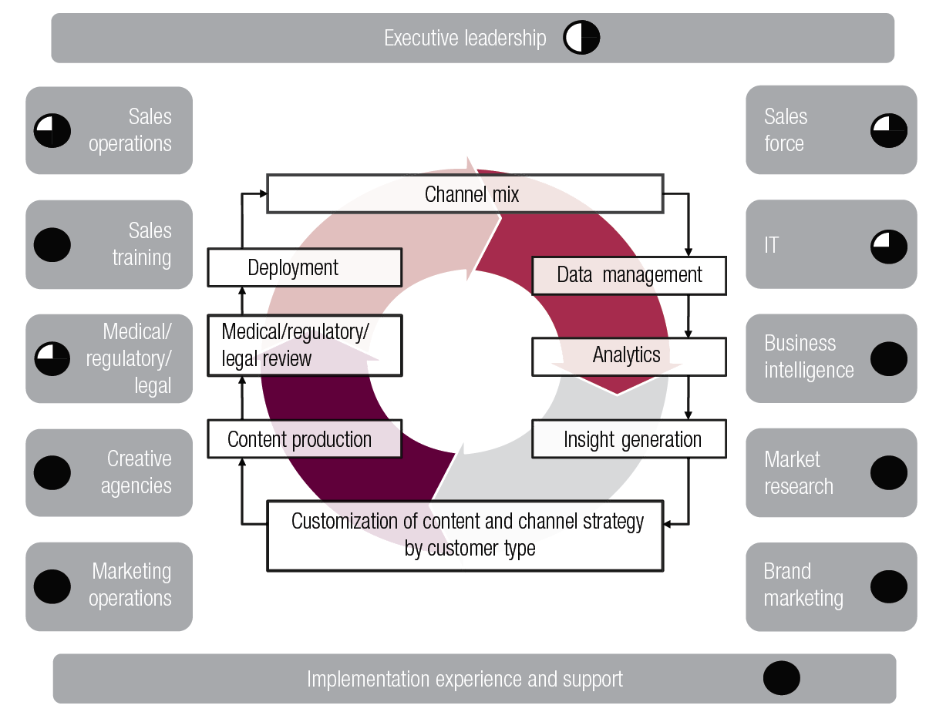
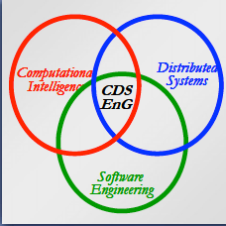
Summary and presentation for CDS project
by
Xinyu Yun
2015.10.30
ECE9607 - Xinyu Yun

Slide 2
Project Targets - Identify the CDS design on interaction protocol with privacy concerns - Build trusted brokering layer/agent to support the interaction protocol - Deliver the environment for future’s research & verification - Skill enhancement on Heroku, DEX, salesforce.com
ECE9607 - Xinyu Yun

Slide 3
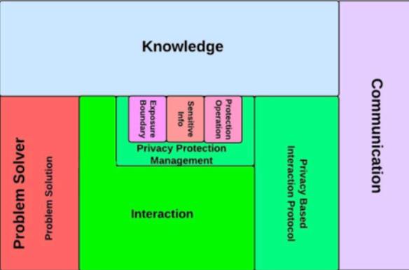

Quick review the interaction with privacy concerns
Entity level: from basic agent model to Privacy-Aware Agent Model
Sensitive Information Checking
Exposure Boundary
Operation Protection
ECE9607 - Xinyu Yun

Slide 4
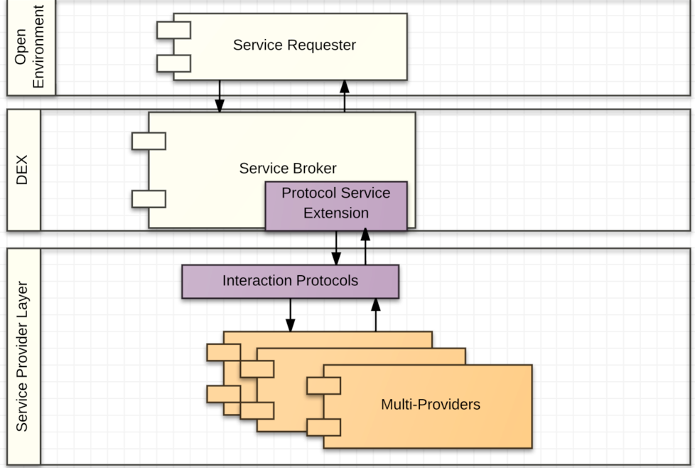


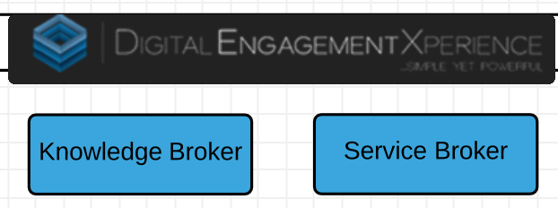
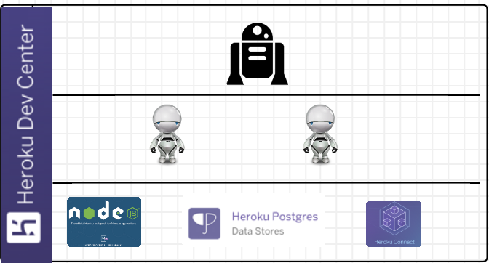
Proposed Solution - Architecture
Requesters and Providers are all deployed in open environment
Communication and interaction will be through the trusted brokering layer
ECE9607 - Xinyu Yun

Slide 5
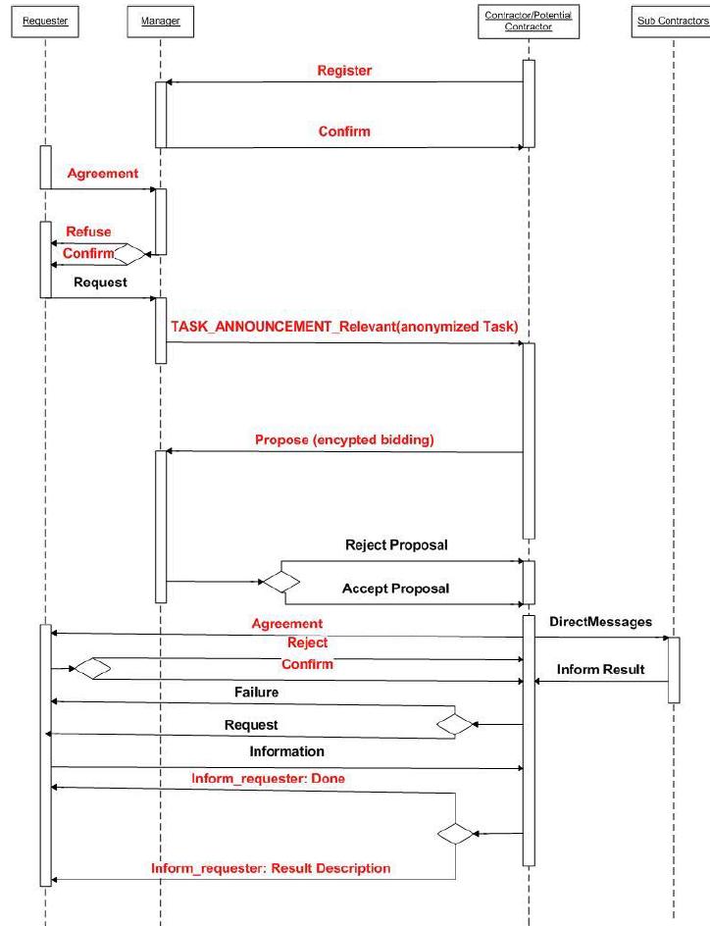
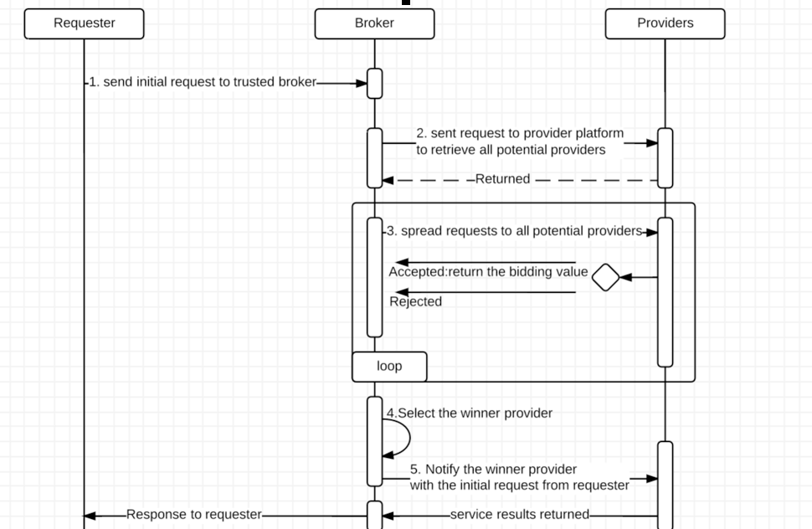


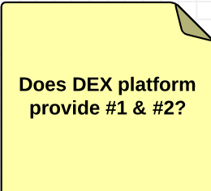
the interaction protocol with privacy concerns
Framework level: from CNP to Privacy-Based CNP
1.Trusted Brokering Registration
2.Anonymized Task Announcement
3.Encrypted Bidding and result
ECE9607 - Xinyu Yun

Slide 6
Project progress and future plan
Build interaction manager agent in Heruko - ongoing
Design & Implenment the requestor routing strategy applied in Heroku & Node.js - next week
Design & Implenment the encryption strategy for bidding interaction in Heroku & Node.js - Nov 20th
ECE9607 - Xinyu Yun

